Slide 1
Unit 2 – Game Basics, MDA Framework

Slide 2
Overview
MDA Framework
Analyzing a Game
Other Frameworks
Common Mechanics and Dynamics
Spotlights

Slide 3
Why Is This Important?
We are continuing to develop a common language and vocabulary to discuss games with
We are continuing to gain shared experiences with games and expanding our world of games
We will learn how to analyze our favorite games using the MDA framework
We will analyze games and examine common mechanics and dynamics

Slide 4
MDA Framework

Slide 5
Objectives
I know what a framework is and why we are using one to analyze games
I can explain what comprises the MDA framework and give examples of what constitutes each one
Mechanics
Dynamics
Aesthetics

Slide 6
MDA Framework
What is a framework?
“A basic structure underlying a system, concept, or text.”
We use frameworks every day to help us understand something better:
Classical Physics vs Quantum
Euclidean Geometry vs Hyperbolic/Spherical
What do you learn/use in K-12 school?
*Please note these are arbitrary breakdowns and I am definitely not qualified to make such distinctions. I feel however these analogies will help students better understand 1) the idea of what a framework is and 2) some frameworks are easier to start with than others.
Notes:
https://physics.stackexchange.com/questions/21871/what-are-the-frameworks-of-physics

Slide 7
MDA Framework
Proposed at the Game Developers Conference (2001)
Formalized in “MDA: A Formal Approach to Game Design and Game Research”
Robin Hunicke, Marc LeBlanc, Robert Zubek (2004)
Most well known framework for game analysis
Three elements:
Mechanics: The particular components of the game at the level of data representation and algorithms
Dynamics: The runtime behavior of the mechanics acting on player inputs and each other’s outputs over time
Aesthetics: The desirable emotional responses invoked in the player when she interacts with the game system
Notes:
https://physics.stackexchange.com/questions/21871/what-are-the-frameworks-of-physics

Slide 8
MDA Framework - Mechanics
Mechanics: Another term for what others might commonly call a “rule”. How something works - if you do X, then Y happens.
Ex: If you land on someone’s property in Monopoly, then you pay them $$$.
Ex: If you draw a red card in Candy Land, then you go to the next red space.
Ex: If you press this button on your controller in Fortnite, then you do ___________.
“Mechanics are the rules that act upon the players, avatars and game bits, game state and game views, and describe all of the ways to change the game state.”
Notes:
https://physics.stackexchange.com/questions/21871/what-are-the-frameworks-of-physics

Slide 9
MDA Framework - Mechanics
Go to https://boardgamegeek.com/ and search by mechanics!
Browse -> Mechanics
Notes:
https://physics.stackexchange.com/questions/21871/what-are-the-frameworks-of-physics

Slide 10
MDA Framework - Mechanics
Setup: How do you start the game?
Victory Condition: How do you win?
Progression of Play: How do you play the game?
Player Actions: What actions can I take?
Definition of Game View(s): What information am I privy to at any point in time?
Notes:
Taken from Brathwaite and Schreiber

Slide 11
MDA Framework - Dynamics
Dynamics: A pattern of play that comes from players once they implement the mechanics.
Note: Not all dynamics are explicitly defined or enforced by the mechanics.
Ex: The game of Risk, players strive to conquer the entire world. Interactions take place between players outside of the game state via player negotiations/alliances, discussion, etc.
Ex: Trash talking and online chat in many online multiplayer games (looking at you LoL and CoD).
Ex: The game of Secret Hitler, Sheriff of Nottingham, and any such game that ‘encourages’ lying and duplicity.
*Think of dynamics as how players actually interact with the game and each other once they begin playing.
**Think of dynamics as answering the question, “What is the game experience all about?”
Notes:
Taken from Brathwaite and Schreiber

Slide 12
MDA Framework - Dynamics
Territorial Acquisition - controlling a piece of territory; limited resources
Risk, Carcassonne
Prediction – doing the right thing at the right time; guessing
Rolette, Rock-Paper-Scissors
Spatial Reasoning – puzzle games
Tetris, Tic-Tac-Toe, Connect Four
Survival – trying to survive until the game ends
Slender Man, Amnensia, Outlast
Destruction – destroy everything
Nuclear War, Plague and Pestilence, Twilight Struggle
Notes:
Taken from Brathwaite and Schreiber

Slide 13
MDA Framework - Dynamics
Building – improving your own conditions, developing resources
Roller Coaster Tycoon, Settlers of Catan, Junk Art
Collection – pattern matching and collectable card games
Yugioh, Magic the Gathering, Sequence, Code Names
Chasing or Evading – capturing prey or escaping predators
Pac-Man, Scotland Yard
Trading – player cooperation and negotiation
Animal Crossing, Pokémon (evolve/collect certain pokémon)
Race to the End – be the first to reach the end (many games for children)
Candy Land, Sorry, Life, Chutes and Ladders, Trouble
Notes:
Taken from Brathwaite and Schreiber

Slide 14
MDA Framework - Dynamics
Playtesting is the only way to understand dynamics!
Notes:
https://physics.stackexchange.com/questions/21871/what-are-the-frameworks-of-physics

Slide 15
MDA Framework - Aesthetics
Aesthetics: the emotional responses evoked in the player when they interact with the game system
Note: every player will have differing emotional responses, so this is subjective!
Things to keep in mind when considering aesthetics:
Theme
Artwork
Music
Notes:
Taken from Brathwaite and Schreiber

Slide 16
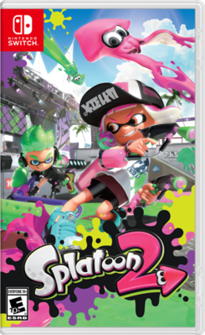
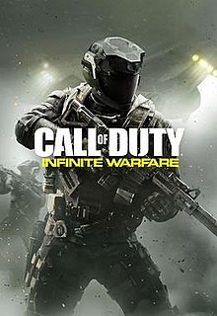

MDA Framework - Aesthetics
FPS: Splatoon
Trailer: https://www.youtube.com/watch?v=qN4w5D2tzME
FPS: Call of Duty
Multiplayer Trailer: https://www.youtube.com/watch?v=J7Ivdq5E-fs
FPS: Fortnite
Battle Royale Trailer: https://www.youtube.com/watch?v=2gUtfBmw86Y
These are all FPS games, yet they feel drastically different from each other. Why? Aesthetics.
Notes:
Taken from Brathwaite and Schreiber

Slide 17
MDA Framework - Aesthetics
Something as simple as adding a timer can drastically change how players respond to a game.
Example 1: Mario
Adding the time limit encourages players to finish the map faster to score higher
Example 2: Fortnite Battle Royale
Without the timer, players can spread across the map and camp out
Because of the timer (in the form of an ever-shrinking circle), players are forced to be proactive and have to move around the map
Example 3: Counter Strike
Without the timer of a planted bomb, it becomes just another fps shooting game
The planted bomb timer adds another win condition and forces the two sides to engage with each other
Notes:
Taken from Brathwaite and Schreiber

Slide 18

MDA Framework - Aesthetics
Bohnanza: a game about bean farming
Goal: Earn as many coins as possible
You have to trade with others to win
This could easily be a game about potato farming or some other crop
Super Mario Bros: a plumber trying to save a princess
Why a plumber? Why a mushroom kingdom?
Katamari Damacy: a prince making up for his father (who destroyed all celestial bodies in the university) by rolling over things to create a bigger sphere to recreate the things destroyed
Overcooked: Timer, layouts of kitchen, hazards
Personal gameplay footage!
Game designers make deliberate choices about every aspect of their game.
Notes:
Taken from Brathwaite and Schreiber

Slide 19

MDA Framework
Designers and players view games from different directions
Designers first consider the aesthetic feelings they want players to experience
Then consider the dynamic play that will engender these aesthetics
Finally create mechanics that will lead to these dynamics
Players first read the rules of the game (mechanics)
These rules lead to dynamic play
The dynamics engender aesthetic feelings
Notes:
Slide taken from Bond

Slide 20
Objectives
I know what a framework is and why we are using one to analyze games
I can explain what comprises the MDA framework and give examples of what constitutes each one
Mechanics
Dynamics
Aesthetics

Slide 21
Analyzing a Game

Slide 22
Objectives
I can apply the MDA framework to analyze a game of my choosing
Pick a game you’re familiar with!

Slide 23
Analyzing a Game: Mr. Wang’s Version
Hollow Knight Basic Information:
Developer: Team Cherry (Australian-based team)
Release Date: February 24, 2017
Free Expanded Content:
Godmaster
Lifeblood
The Grimm Troupe
Hidden Dreams
Sequel: Hollow Knight Silksong
Main Idea: You play a character exploring an ancient kingdom of bugs with no recollection of who they are. As you progress, you will gain new abilities, your memory, and perhaps uncover what happened in this fallen kingdom.

Slide 24
Analyzing a Game: Mr. Wang’s Version
Hollow Knight Mechanics:
Typical metroidvania game: https://en.wikipedia.org/wiki/Metroidvania
2D controls
Walk, jump, hit, fly, read, “dreams”, more
Concept of “Soul”
Used for attacking and healing
Masks/”Hearts”
How many times you can get hit before dying
Equip charms and upgrade nail weapon
Gain new abilities that enable you to do more actions

Slide 25
Analyzing a Game: Mr. Wang’s Version
Hollow Knight Dynamics:
Certain charm combinations can create synergistic effects
Nail ‘bouncing’
Exploration

Slide 26
Analyzing a Game: Mr. Wang’s Version
Hollow Knight Aesthetics:
Silent protagonist – no voice/dialogue options
Storyline – your own history and exploring the ruins of a bug kingdom
Music – how does the music contribute to the game?
Art – how does the art contribute to the game?

Slide 27
Analyzing a Game: Mr. Wang’s Version
Further Reading/Watching:
What is a Metroidvania? https://www.youtube.com/watch?v=4BRo_E8LnHA
Hollow Knight Wiki: https://hollowknight.fandom.com/wiki/Hollow_Knight_Wiki

Slide 28
Analyzing a Game
You will be writing yours in complete sentences in a paragraph format.
How long should it be? For the purposes of our first game analysis assignment, let’s say 1 paragraph for each.
More details in the Analyzing a Game Assignment Rubric!

Slide 29
Objectives
I can apply the MDA framework to analyze a game of my choosing

Slide 30
To Do:
Analyzing a Game Assignment!
Again, see ItsLearning for rubric and submission (don’t worry you have more days to work on this!)
Scaffolding:
Explaining the MDA Design Framework: https://www.youtube.com/watch?v=NxiGduvDJ8s
Becoming a Better Game Developer (MDA Framework): https://www.youtube.com/watch?v=5DTDZ5yXFeA
An Analysis of “Fun” for Casual and Social Games: https://www.youtube.com/watch?v=5JUhEUPLVKM
MDA Framework: https://www.youtube.com/watch?v=UBN0or7btnY
*See Scaffolding document

Slide 31
Other Frameworks: Formal, Dramatic, & Dynamic
Taken from bond PPT

Slide 32
Objectives
I can explain the strengths of the Formal, Dramatic, & Dynamic framework and what it focuses on

Slide 33
Formal, Dramatic, and Dynamic Elements
From Game Design Workshop by Tracy Fullerton
Formal elements: The elements that make games different from other forms of media or interaction and provide the structure of a game. Formal elements include things like rules, resources, and boundaries.
Dramatic elements: The story and narrative of the game, including the premise. Dramatic elements tie the game together, help players understand the rules, and encourage the player to become emotionally invested in the outcome of the game.
Dynamic elements: The game in motion. Once players turn the rules into actual gameplay, the game has moved into dynamic elements. Dynamic elements include things like strategy, behavior, and relationships between game entities.

Slide 34
Formal, Dramatic, and Dynamic Elements
A game ceases to be a game if the formal elements are removed
Seven formal elements of games
1. Player interaction pattern: How do the players interact?
Single-player
One-on-one
Team versus team
Multilateral (multiple players versus each other)
Unilateral (one player versus all the other players)
Cooperative play
Multiple individual players each working against the same system
2. Objective: What are the players trying to achieve in the game? When has someone won the game?

Slide 35
Formal, Dramatic, and Dynamic Elements
Seven formal elements of games
3. Rules: Limit the players' actions by telling them what they may and may not do in the game.
Many rules are explicit, but others are implicitly understood
4. Procedures: Actions taken by the players in the game
A rule tells the player what to do
The procedure dictated by that rule is the actual action of the player
Procedures are often defined by the interaction of a number of rules
Some procedures are also outside of the rules: Bluffing in Poker
5. Resources: Elements that have value in the game
Money
Health
Items
Property
35

Slide 36
Formal, Dramatic, and Dynamic Elements
Seven formal elements of games
6. Boundaries: Where does the game end and reality begin?
"A game is a temporary world where the rules of the game apply rather than the rules of the ordinary world" – Johan Huizinga, Homo Ludens (1955)
This concept is now known as the Magic Circle
In a sport like football or ice hockey, the magic circle is defined by the boundaries of the playing field
In an Alternative Reality Game like I Love Bees (the ARG for Halo 2), the boundaries are more vague
7. Outcome: How did the game end?
Both final and incremental outcomes
In Chess, the final outcome is that one player will win, and the other will lose
In an RPG, there are several incremental outcomes
36

Slide 37
Formal, Dramatic, and Dynamic Elements
Dramatic elements of games
Make the rules and resources more understandable
Give players greater emotional investment in the game
Three dramatic elements of games
1. Premise: The basic story of the game world
Monopoly: The players are real-estate developers trying to get a monopoly on corporate real estate in Atlantic City, New Jersey
Donkey Kong: The player is trying to single-handedly save his girlfriend from a gorilla that has kidnapped her
The premise forms the basis around which the rest of the game's narrative is built
37

Slide 38
Formal, Dramatic, and Dynamic Elements
Three dramatic elements of games
2. Character: The individuals around whom the story revolves
Vary widely in depth
The main character of Quake is nameless and largely undefined
Nathan Drake, from the Uncharted games, is as deep and multidimensional as the lead characters in most movies
In movies, the goal of the director is to encourage the audience to have empathy for the film's protagonist
In games, the player actually is the protagonist character
Designers must choose whether the protagonist will act as
An avatar for the player
A role that the player must take on
Most common of the two
Much simpler to implement.
3. Story: The plot of the game
The narrative that takes place through the course of the game
38

Slide 39
Formal, Dramatic, and Dynamic Elements
Dynamic elements of games
Occur only when the game is being played
Core concepts of dynamic elements
Emergence
Simple rules lead to complex and unpredictable behavior
One of a game designer's most important jobs is to attempt to understand the emergent implications of the rules in a game.
Emergent narrative
Narrative can also be dynamic
Narratives can emerge from the gameplay itself
One of the central appeals of RPGs like Dungeons & Dragons
Different from the narrative embedded in cut scenes and plot
Unique to interactive experiences.
39

Slide 40
Formal, Dramatic, and Dynamic Elements
Core concepts of dynamic elements
Playtesting is the only way to understand dynamics
Game systems are unpredictable
Experienced game designers can make better guesses
But, everyone must playtest to understand a game
40

Slide 41
Formal, Dramatic, and Dynamic Elements
Using Tracey Fullerton’s framework helps give designers tools to make better games.
We will be utilizing primarily this framework in our next unit when we undergo more game design exercises.

Slide 42
Objectives
I can explain the strengths of the Formal, Dramatic, & Dynamic framework and what it focuses on

Slide 43
Other Frameworks: Elemental Tetrad
Taken from bond

Slide 44
Objectives
I can explain the portions of the Elemental Tetrad and its strengths

Slide 45
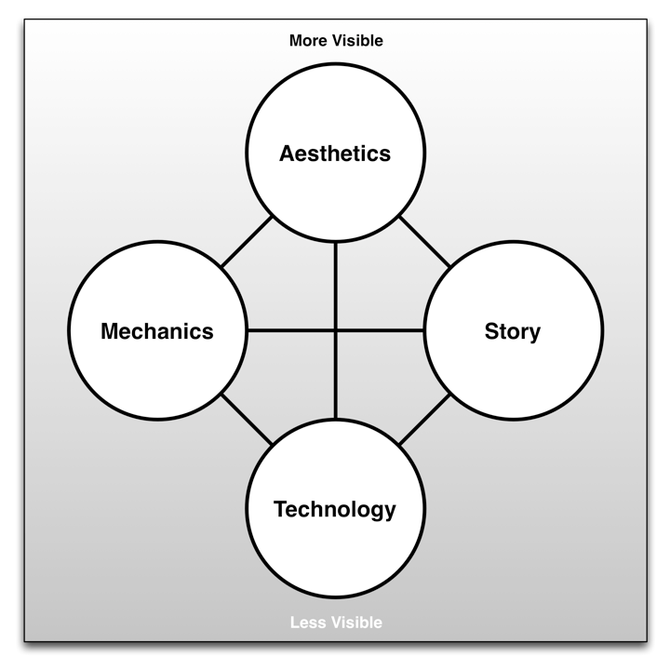
The Elemental Tetrad
From The Art of Game Design: A Book of Lenses by Jesse Schell
A tetrad of elements
45

Slide 46
The Elemental Tetrad
Mechanics
Rules for interaction between the player and the game
Differentiate games from other non-interactive media
Contain
Rules
Objectives
Other Formal elements
Different from mechanics in MDA
Schell differentiates between mechanics and technology
46

Slide 47
The Elemental Tetrad
Aesthetics
Describe how the game is perceived by the five senses
Vision
Sound
Smell
Taste
Touch
Many different aspects of aesthetics
Soundtrack
3D graphics and animation
Packaging and cover art
Different from aesthetics in MDA
MDA aesthetics describes the emotional response to the game
Schell's aesthetics describe the five senses
47

Slide 48
The Elemental Tetrad
Technology
The underlying technology that makes the game work
Digital technologies
Computer and console hardware
Software and programming
Rendering software and pipelines
Paper technologies
Dice and other randomizers
Statistics tables
48

Slide 49
The Elemental Tetrad
Story
Everything included in Fullerton's Dramatic Elements
Differs from Fullerton's Dramatic Elements because it is broader than what she terms story.
Schell's story includes premise and character as well
49

Slide 50
The Elemental Tetrad
Schell arranges the elements in a tetrad
Four elements also represent four groups in a game studio
Arranged from most to least visible
50

Slide 51
Summary
Each framework has a different perspective
MDA demonstrates that gamers and designers approach games from different directions
Encourages designers to see games from the perspective of players
Formal, Dramatic, & Dynamic breaks games down into specific components that can be isolated, tweaked, and improved
Elemental Tetrad views games from the perspective of a development studio

Slide 52
Objectives
I can explain the portions of the Elemental Tetrad and its strengths

Slide 53
Other Frameworks: Layered Tetrad
Taken from bond

Slide 54
Objectives
I can explain what The Layered Tetrad framework is and what it is comprised of

Slide 55
The Layered Tetrad
The last chapter presented several frameworks
This Layered Tetrad is the framework of this class
Expands upon those that came before it
Considers the cultural significance and impact of games
Does not define what a game is
Instead helps you understand and analyze
The elements that are needed to make a game
The dynamic behavior of those elements during play
Both the impact of the game on culture and the affect of culture on the game
We use the term game, but this is applicable to any form of interactive media or experience
55

Slide 56
The Layered Tetrad
Presented in a tetrad (based on Schell's)
Mechanics: The systems that define how the game will react to play. The elements that separate games from other media
Aesthetics: The looks, sounds, smells, tastes, and tactile sensations of the game. Game art, sound, and more.
Technology: The underlying tech that makes the game work.
Narrative: The story, premise, characters, etc. of the game. Renamed from Schell's to show its breadth.
Presented in three layers
Inscribed: The game as created and encoded by the developers
Dynamic: The game's behavior during play
Cultural: The game's relationship to society
56

Slide 57
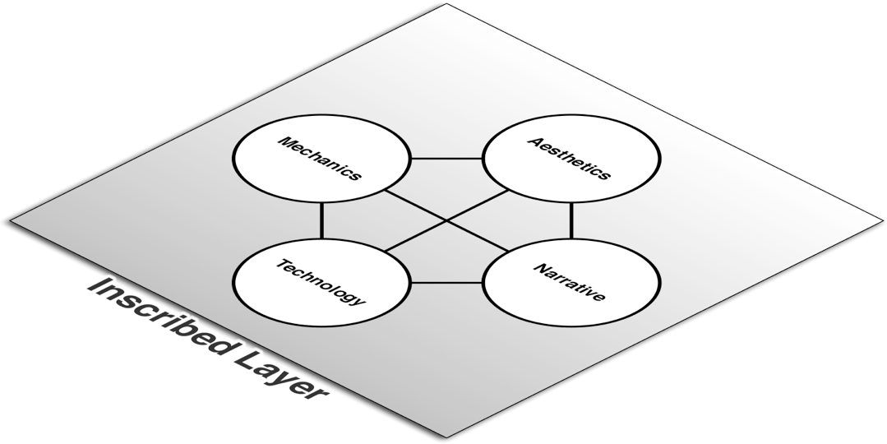
The Inscribed Layer
Game as created and encoded by developers
Similar to Schell's Elemental Tetrad
Limited to elements that exist when the game is not being played
57

Slide 58
The Inscribed Layer
Mechanics
Systems that define how the player and game will interact
Includes: Player interaction pattern, Objective, Rules, Resources, Boundaries
Aesthetics
How the game looks, sounds, smells, tastes, and feels
Technology
Paper and digital technology that enable gameplay
Narrative
Authored premise, characters, and plot
58

Slide 59

The Dynamic Layer
The game as it is being played
Players move the game into the dynamic layer
Players

Slide 60
The Dynamic Layer
Mechanics
Players' interactions with inscribed mechanics
Includes: Procedures, Strategies, Emergent game behavior, Outcome
Aesthetics
Aesthetics that are generated during play
Play environment
Technology
Execution of inscribed technology and code
Narrative
Narrative created as a part or result of gameplay

Slide 61

The Cultural Layer
The game beyond play
Intersection of game community and society
Society
Communities
Players

Slide 62
The Cultural Layer
Mechanics
Game mods created by players that alter the Inscribed Layer
Impact of emergent play on society
Aesthetics
Fan art, remixes, cosplay
Does not include authorized transmedia
Technology
Game tech used for non-game purposes
Effect of external cheating technology on game
Narrative
Fan-made narratives

Slide 63
The Cultural Layer
The divisions between the four elements are less crisp in the Cultural Layer
The four elements intermingle in several of the examples from the last slide
The Cultural Layer is also the only layer of a game that non-players will ever see
People who don't play a game experience it through the stories told by those who have
The collision of the community of players and larger society
What messages are our games sending into society?

Slide 64
The Responsibility of the Designer
All designers understand their responsibility for the Inscribed Layer
Most understand their responsibility for the Dynamic Layer
Example of Team Fortress 2 hat behavior
Responsibility at the Cultural Layer?
The common perception of games
Puerile, Vulgar, Violent, Misogynistic
Does it have to be this way?
Games can be…
Prosocial
Educational
Meaningful
What else?

Slide 65
The Responsibility of the Designer
What can interactive media become?
How can you as designers push the term game beyond what it means now?
How can you make your families and friends proud that you're entering this industry?
How can you respect your players and treat them well?
I believe that it is our responsibility as designers to
Promote pro-social, thoughtful behavior through our games
Respect our players and the time that they dedicate to experiencing what we create.

Slide 66
Summary
The three layers represent a transition of agency from the developers to the players of a game
The Inscribed Layer is entirely controlled by developers
The Dynamic Layer is controlled by both developers and players
The Cultural Layer is influenced by developers but ultimately controlled by players and society at large

Slide 67
Objectives
I can explain what The Layered Tetrad framework is and what it is comprised of

Slide 68
Spotlight: Analyzing Horror Games
What makes each one different?

Slide 69
Spotlight: Amnesia The Dark Descent
The Last Bacon: https://www.youtube.com/watch?v=UfktQ0lP_J4

Slide 70
Spotlight: Five Nights at Freddy’s

Slide 71
Spotlight: Slender Man

Slide 72
Spotlight: Outlast
https://www.youtube.com/watch?v=fATGHokgpoA

